Slide 1

Strict Transport Security Implementation on http/https conversion
Ahmet Gürbüz
Murat Gün
Notes:
GIRIS
First of all, Hello everyone, Today we will try to explain to what Strict Transport Security Implementation on http/https conversion is in general. We will also try to show you why this technology is developing and what works.

Slide 2

Agenda
What is http (Hypertext Transfer Protocol) ?
What is HttpS (Secure Http)
What is ssl/tsl?
What is HSTS?
Some Google Improvments for web
Attack Types
Demos
Notes:
AGENDA
I would like to summarize our presentation in general.
To begin with, we will go over the basic concepts for better understanding.
These are http HTTPS ,ssl/tls concepts.
Next, we will examine the evolution of the HSTS concept and what is hsts
And we will explain to You the attack demos we made.

Slide 3

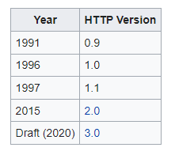


What is http (Hypertext Transfer Protocol) ?
The protocol that is used for viewing web pages.
In its simplest form, it is a bridge that provides data flow between the server and our browser.
all information is sent in clear text.
Vulnerable
can be tracable.
password..
payment#$
Notes:
What is HTTP
So what is this http ? Http is simply the protocol that enables data flow between websites and web browsers.
This protocol was started to be developed in 1989 by Tim Berners-Lee, the inventor of the World Wide Web, in the early years of the Internet. Over the years, this protocol has been developed with the internet. As you can see on the screen, we are currently using version 2.0 of this protocol. However, version 3.0 was introduced in 2020. This protocol is still used, but it has a general weakness. As you can see in the animation, this weakness is that it sends data in simple texts. This kind of situation makes us valnurıbıl to attacks.

Slide 4

What is HttpS (Secure Http) ?
This is a http with a security feature.
Encrypts the data that is being retrieved by HTTP.
Uses encryption protocol to scramble the data that’s being transferred.
=
Http
SSL/TSL
HttpS
Notes:
WHAT is HTTPS
For this reason, https has been developed as an alternative to http. HTTPS is the sending or receiving of data encrypted with SSL or TLS protocol with HTTP protocol. The development of https basically arose out of the need for privacy. And it first came out in 1995, and it continues to evolve with ssl-tls.
In fact, simply put http plus SSL/TLS = HTTPS.
Ok we got .HTTPS but what is SSL/TLS?

Slide 5
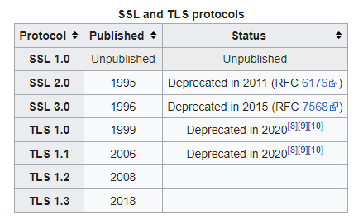




What is Ssl / Tls?
Encryption protocol
autenticate the identity.
Web Browser:
Server Identify Yourself
Web Server:
Look At My certificate to prove my ID
Web Browser: Ok I looks good.
I can trust you.
Notes:
What is SSL/TLS
Protocol that’s used to ensure security on the internet. It uses public key encryption to secure data.
The animation below shows how ssl works. So computer connects to a web site that’s using ssl, the computer’s web browser ask to the web server to identify it self. Then the web server will send the computer a copy off its ssl certificate. An ssl certificate is a small digital sertificate that is used to autanticate the identity of a web server or a web site . Basicly it’s used to let your computer know that the web site is trusthworthy or safe. Computers web browser’s checks to make sure that it trust the certificate. And browser send a message web server. Then after web server respond back with an aknowlacment . Ssl session can proceed. After the all steps your browser and web server sending encrypted data each other. This is basicly how ssl Works.
And also tls the lastest industry standard cryptographic protocol. It’is succesors to ssl. Tls based on the same spesifications.

Slide 6

What is HSTS?
It is a mechanism that converts incoming http connections to https.
http://obs.mu.edu.tr
Redirect to https://obs.mu.edu.tr
https://obs.mu.edu.tr
Strict–Transport–Security Header
Notes:
HSTS (strict transport security header)
After going over the basic concepts, we can come to main topic.
HSTS let website tells the browsers that it should be only accessed using https protocol insted of using http.
This is a hsts flow. Browser wants to acces obs.mu.edu.tr using with http protocol. The server redirecting to https. Then browser again acces obs.mu.edu.tr but this time using with https protocol. While responding the server will send Strict transport security header.

Slide 7

What is HSTS?
Well, if we were to reach the server in this way in every transaction, wouldn't we be creating unnecessary traffic on the server?
First In-Secure Request
Subsequent In-secure Request
http://obs.mu.edu.tr
http://obs.mu.edu.tr
Redirect to https://obs.mu.edu.tr
Internal Redirect to Secure URL
https://obs.mu.edu.tr
https://obs.mu.edu.tr
Strict–Transport–Security Header
Notes:
Well. İf we were to reach the server in thgis way in every transaction, wouldn’t we be creating unnecesesarry trafic on the server ?
I think that would be a serious problem. Imagine getting tons of requests that you need to respond. A situation like ddos attacks could be happened.
To solve this situation, the mechanism changes a little bit.
We make this change using with the Strict transport security header, which is returned to us at the end of the first mechanism.
What’s stirict transport security header?
We will talk about these on the next slide. But let's talk briefly about max-age here. This header has 3 parameters.
The max age parameter tells the web browser how long the hsts rule is valid. During this time, the web browser automatically converts incoming requests for this site to HTTPS without going to the server.
for this reason, the mechanism is as shown on the screen.
Browser wants to reach web site using http protocol but web browser does not allow this. Redirected to automaticly and than send request the server.

Slide 8
HSTS Header
max-age: the time, in seconds, that browser should remember that site is only to be accesable with https.
inculudeSubDomanins: Optional parameter, this rule applies to all of the site’s subdomains.
Preload: Optional parameter, Activate HTST preload service maintained by Google.
Notes:
This is a hsts header. İt has 3 parameter.
We talked about max age but let's say it again. max age parameter tells the web browser how long the hsts rule is valid. During this time http request automaticly convert https by web browser.
Whenever hsts header delivered browser, max-age updated.So prevent the timeout from expiring.
Setting max-age to zero, that means immediately expire and this allows the acces via http.
includeSubDomains is the parameter generally used to make the hsts mechanism work for all your subdomains.
Let's talk about this in a little more detail.

Slide 9
Some Google Decisions
Google's update in July 2018 started to show sites without SSL certificates in low rankings in search engines.
Chrome also now warns users against sites without SSL certificates.
Also released HSTS preload service.
Notes:
Some Google improvments
Google's update in July 2018 started to show sites without SSL certificates in low rankings in search engines.
this is actually a decision taken to increase the use of ssl certificates on websites.
We will see the usage rates of these protocols in the coming slides, but I can say that the overall number is low.
Chrome(google’s web browser) also now warns users against sites without SSL certificates.
they tried to protect the user in general
if you go to a site without ssl certificate. you can see this.

Slide 10


Preload Service
Activates the hsts protocol on the website with preload keyword.
WebSite Owner
https://obs.mu.edu.tr
http://obs.mu.edu.tr
HSTS Preload List
Web Server
Checks obs.mu.edu.tr
in HSTS Preload List
Website User
Strict-Transport-Security: max-age=31556926;inculudeSubDomains;preload
Notes:
preload service is a whitelist provided by google. Those who meet the necessary conditions can register to this list own web site.
so why do we use this ?
Still with hsts header browser loads the very first request to the web site through(true) insecure protocol http. This can lead to atack. Attack can be mitigated by enabling the preload service.
The service is hosted by Google but all browsers have started using the preloadlist.
However preload service not part of hsts specification.
This is the preload service mechanism
We have 4 partners.
Firstly, WebSite Owner, Activates the hsts protocol on the own website with preload keyword and registered the list.
And than, if the website user wants to access this site via http. the user's browser goes to preload list finds this site in the list. And convert http to https.
Server response the hsts header.

Slide 11
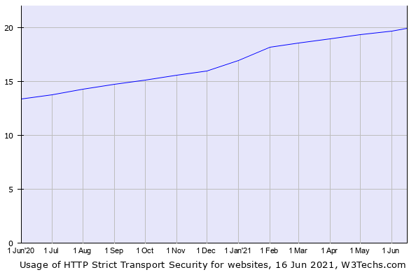
HSTS Usage Popularity
https://w3techs.com/technologies/details/ce-hsts de los Santos, Sergio, et al. "Implementation state of HSTS and HPKP in both browsers and servers." International Conference on Cryptology and Network Security. Springer, Cham, 2016.
Table 1. HSTS usage rates Among 10 million sites
Notes:
As a result of the researches, it has been determined that the usage is increasing among 10 million sites. However, it should be said that there is still around 20% usage. You can review the more detailed table from 2 different sources above.

Slide 12


Attack Types
Man In The Middle
Website User
Web Server
HTTP
HTTPS
Attacker
Notes:
İf a website accepts a connection http and redicets to https, your visitors may initially communicate with http version of site.(http version non-encrypted version). For example if your have bank or e shopping site. This provides to stealing your customer credit card information.
The redirect could be exploited to direct the visitors to a malicius site.
So please look at a animation, Website user wants to cominicate sercure version a web site from the web server but initial url was http this will lead to ssl stripping or downgrade attack by attacker in the middle. HSTS informs the browser never load a site http and it say to browser convert the http to https.
the attacker cannot easily obtain the data even if they get in between data stream ,because the data is encrypted using https. So hsts provides this generaly.

Slide 13
Thank You For Listening…
Next - Demos

